Slide 1
General Education Committee
November 2019 Meeting

Slide 2
UF UNDERGRADS BY THE NUMBERS

Slide 3
UF UNDERGRADS BY THE NUMBERS – Fall 2018
Total Number:
37,527 (Fall 2018)
Transfer Admits:
3792 (2017-’18)
Largest Majors: Mechanical Engineering (2312)
Psychology (1854)
Number of Degrees (2018):
9,347
Number of
Freshmen (2018):
7349 - All
(6802 - UF Main)
4.42 Avg. H.S. GPA
1353 SAT
30.02 ACT
~10% Honors
30% Pell

Slide 4
GENERAL EDUCATION
BY THE NUMBERS

Slide 5
Total Active General Education Courses as of Fall 2019
General Education Designation | Active Courses
Biological Sciences | 81
Composition | 18
Humanities | 433
Mathematics | 36
Physical Sciences | 89
Social & Behavioral Sciences | 197
Total GE Courses | 854
Courses with Shared GE Designations
Diversity | 51 (6%)
International | 374 (44%)
Composition (Shared) | 16 (2%)
*There is no current data for Writing courses

Slide 6
Fall 2019
Total Enrollment in General Education Courses
76,695
Total Credit Hours Offered Through General Education Courses
6,322

Slide 7
SERU 2017 SURVEY RESULTS

Slide 8
Compare your level of proficiency when you enrolled at UF and now (Scale: 1-6)
4.01/5.15
Analytical/ critical
thinking
3.08/4.53
Understanding your field of study
3.85/4.35
Quantitative skills
3.67/4.91
Leadership skills
4.06/5.08
Interpersonal skills
3.28/4.19
Design, conduct, evaluate research
3.5/4.79
Understand international perspectives
3.91/5.05
Read and comprehend
4.05/5.00
Writing skills
Data Source: SERU 2017 Survey (ir.ufl.edu)

Slide 9
Hours a week spent on e-devices for non-academic purposes
26 or more: 6%
16-25: 14%
11-15: 17%
6-10: 32%
0-5: 30%
(6129 students)
EXPECTATIONS MATTER
Set Them High Early and Often
Hours a week
spent studying
26 or more: 12%
16-25: 26%
11-15: 21%
6-10: 26%
0-5: 15%
(6134 students)
How often were your academic efforts increased because of high standards of a faculty member?
Very often: 9%
Often: 23%
Somewhat often: 27%
Never, Rarely, Occasionally: 41%
(6117 students)
Academic cheating is a problem
Agree/strongly agree: 14%
Somewhat agree: 17%
Somewhat disagree: 25%
(1497 students)
Data Source: SERU 2017 Survey (ir.ufl.edu)

Slide 10
RELATIONSHIPS MATTER
Know Them by Name: Relationships Are Central to Learning
0.87
Number of professors I know well enough to ask for a letter of recommendation
(1268 freshmen and sophomores)
Worked with a faculty member on an activity other than coursework
3 or more times: 15%
2 times: 11%
1 time: 22%
Never: 52%
(6133 undergraduate students)
Have you had a class in which a professor knew your name?
Very often: 24%
Often: 20%
Somewhat often: 17%
Never, Rarely, Occasionally: 39%
(6138 students)
Assisting faculty in their research
Essential/very important: 48%
(1491 students)
Data Source: SERU 2017 Survey (ir.ufl.edu)

Slide 11
To What Degree Did the Following Contribute: Percent Answering “Extremely” or “Significantly”
Openness to understand and communicate with others
General education courses: 26%
Courses other than general education: 40%
Connection to a faculty mentor or community mentor
General education courses: 16%
Courses other than general education: 41%
Heightened awareness of needs of others
General education courses: 22%
Courses other than general education: 30%
Knowledge of how multiple disciplines can work together
General education courses: 28%
Courses other than general education: 50%
Data Source: SERU 2017 Survey (ir.ufl.edu)

Slide 12
To What Degree Did the Following Contribute: Percent Answering “Extremely” or “Significantly”
Confirming your choice of major
General education courses: 21%
Courses other than general education: 63%
Connecting your major to what you believe is your life’s purpose
General education courses: 19%
Courses other than general education: 50%
Participate fully and responsibly as an informed global citizen
General education courses: 25%
Courses other than general education: 41%
Increase in valuable skills, including oral and written communication and critical thinking
General education courses: 35%
Courses other than general education: 57%
Data Source: SERU 2017 Survey (ir.ufl.edu)

Slide 13
Of the courses you have taken, could you identify which designations met the General Education requirement?
Level | N | M | I don’t know | I could identify a few | I could identify some | I could identify all
Freshman | 57 | 3.21 | 0% | 16% | 47% | 37%
Sophomore | 235 | 3.24 | 5% | 11% | 39% | 45%
Junior | 427 | 3.15 | 8% | 11% | 39% | 42%
Cont. Senior | 498 | 3.19 | 6% | 13% | 39% | 43%
Graduating Senior | 248 | 3.10 | 7% | 14% | 40% | 39%
Total | 1465 | 3.17 | 6% | 12% | 39% | 42%
Data Source: SERU 2017 Survey (ir.ufl.edu)

Slide 14
THINKING STRATEGICALLY ABOUT UF GENERAL EDUCATION

Slide 15
Describe our UF General Education program. Identify its strengths. Identify its weaknesses.
What does a successful general education program look like in terms of the following:
Student learning
Pedagogical approaches
Leadership
What approaches should UF take to engage all of the institutions in conversation and action surrounding general education?

Slide 16
COMMITTEE BREAK-OUTS

Slide 17
What does success in terms of outcomes look like on your committee?
How often should your committee meet?
What resources does your committee need?
What UF partners should we ask to join this effort?
Identify your committee’s next steps.

Slide 18
SYNTHESIS AND NEXT STEPS

Slide 19
UNDERGRADUATE STUDENTS MATTER

Slide 20
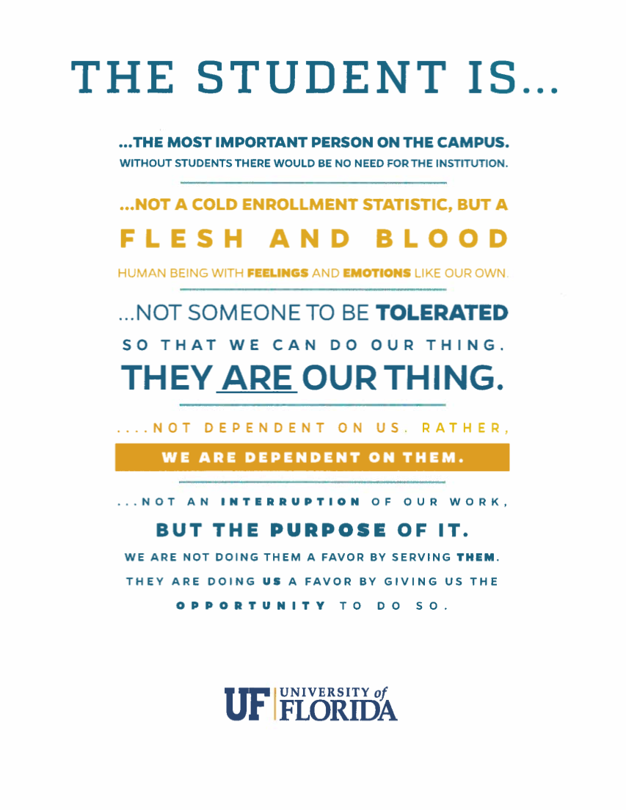
STUDENTS MATTER

